Slide 1
Homelessness Campaign
By Eric, Abinesh, Millan and Abdul

Slide 2
What is our advocacy about?
We are a campaigning group trying to raise awareness of homelessness. Our slogan is; “Your change can make a change”. As a group we have decided to use this slogan as it displays the idea that everyone in our society is responsible and can make a change by helping and supporting organisations like ‘Young Labour’ and ‘Shelter.’

Slide 3
Our aims:
1. We will create a twitter page and aim to get 50 followers. We will tweet facts and statistics regarding homelessness every day to raise awareness of our campaign.
2. We will make an interactive website.
3. We will create a petition to get 80 signatures to show Boris Johnson.
4. We will write a letter to Boris Johnson and the Mp’s so that we can share our thoughts and opinions towards our campaign.
Our overall aim is to raise awareness of homelessness.

Slide 4
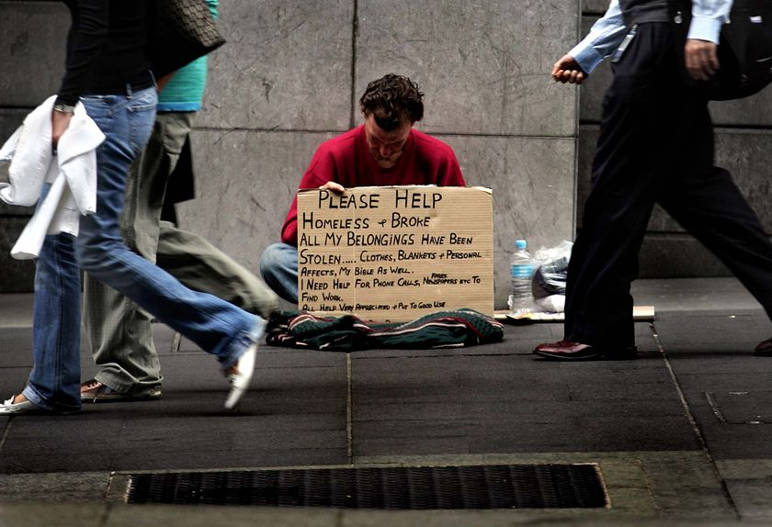
What is homelessness?
Homelessness is when people sleep rough on the streets.
Anyone can become homeless. There are many causes of homelessness such as financial issues.
80,000 young people experience homelessness every year and that figure is rising.

Slide 5
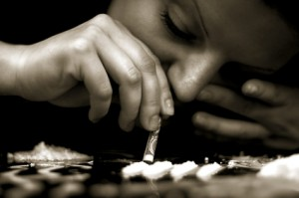
Causes of homelessness:
Family problems
Unemployment
Mental health problems
Drug addiction
Being neglected by friends and family members
Financial problems

Slide 6
3 charities that support homeless people:
Young Labour, Crisis and Shelter
These organisations are all trying to help homeless people in our local area. They also help reduce homelessness nationally.
We have taken facts from these organisation's to help you get an idea how serious this issue is.

Slide 7
Facts about homelessness:
Last year, 112,070 people in England approached their council as homeless, a 26% increase over the 4 years.
6,437 people slept rough at some point in London during 2012-2013, an increase of 75% over the last 3 years.
Up to 70% of homeless people experience mental health problems and the average age of death for a homeless person is 47 compared to 70 of a normal citizen.
28% have formed an unwanted sexual partnership and 20% engaged in sex work to get a roof over their heads.
42% of homeless children are under the age of 6.

Slide 8
Stereotypes
Stereotype: “a widely held but fixed and oversimplified image or idea of a particular type of person or thing”
Stereotypes stereotype about homeless people and this is what causes people to get a negative image of homeless people.
We are trying to minimize the number of stereotypes by raising awareness verbally and through the media.

Slide 9
What can you do to help?
Please visit:
http://www.crisis.org.uk/
http://www.shelter.org.uk/
http://www.younglabour.org.uk/

Slide 10
Thank you
Thank you for listening!
“Your change can make a change”

